Slide 1
ZHAW · VISUALISATION & DATA SCIENCE STORYTELLING II · FS 2025/26
Optimising Product Placement
Using Grocery Purchase Data
Turning 3.2 million Instacart orders into assortment, cross-sell and retention decisions for grocery delivery.
Lara Pestrin · Jonathan Kull · Veprim Mehmeti
Notes:
Welcome — we're Group 11: Lara, Jonathan and Veprim. Our project tackles a practical question for grocery delivery: how do you decide what to stock and where to place it, using only past purchase data? We built an interactive dashboard on 3.2 million real Instacart orders. Over the next few minutes I'll cover the challenge, the data, who the tool is for, and the six findings that came out of it.

Slide 2
THE CHALLENGE
Grocery delivery lives or dies
by its assortment
THE QUESTIONS WE SET OUT TO ANSWER
1
Which products are purchased most frequently?
Thousands of products.
Weekly stocking decisions.
Today — mostly intuition.
2
Which products are commonly bought together?
3
Which products earn the highest customer loyalty?
4
When — by day and hour — are orders placed?
5
What does this mean for assortment and retention?
Grocery Product Placement Analysis · Group 11
02 / 13
Notes:
Quick-commerce platforms like Flink or Gorillas manage assortments of thousands of products, constantly balancing customer demand, storage capacity and delivery efficiency. The assortment planners and buyers who make these calls do it every week — and often from slow, error-prone Excel reports. Our goal was to give them a faster, more visual, data-driven foundation. These five questions framed the entire project: what's bought most, what's bought together, what earns loyalty, when people order, and what all of that means for strategy.

Slide 3
THE DATA
Built on 3.2 million real grocery orders
3.2M
206K
49.7K
21
Orders analysed
Unique customers
Unique products
Departments, 134 aisles
The public Instacart 2017 dataset — six linked tables, fully anonymised.
Grocery Product Placement Analysis · Group 11
03 / 13
Notes:
Everything runs on the Instacart Online Grocery dataset from 2017 — a public, fully anonymised set of US grocery-delivery orders. It's six linked tables: orders, order-products, products, aisles and departments. Around 3.4 million orders in total, of which the 3.2 million 'prior' orders are the basis for every chart you'll see. One caveat to keep in mind: there are no absolute dates — only day-of-week and hour — and it reflects US behaviour in 2017, so we read it as patterns, not exact forecasts.

Slide 4


WHO IT'S FOR
Two people make these calls every week
Sandra
Marco
ASSORTMENT PLANNER
BUYER
34 · Business Administration · 5 years in grocery retail · no coding
28 · Retail Management · 2 years in e-commerce grocery · no coding
NEEDS A fast visual overview of what sells — and what sells together.
NEEDS Evidence for listing, delisting and supplier negotiations.
PAIN Slow, manual reports; co-purchase patterns are invisible.
PAIN Decisions lean on gut feel; loyal niche products stay hidden.
Grocery Product Placement Analysis · Group 11
04 / 13
Notes:
The dashboard is built for two people. Sandra is an assortment planner — 34, business background, five years in grocery retail, comfortable with Excel but not code. She needs a fast visual overview without manual prep, and she's frustrated that co-purchase relationships are invisible in her current tools. Marco is a buyer — 28, two years in e-commerce grocery. He needs hard evidence for listing and delisting decisions and for supplier talks, and today too much rides on intuition while loyal niche products never surface in standard reports. Every view in the dashboard maps back to one of their jobs.

Slide 5
THE PRODUCT
An interactive Streamlit dashboard
Built for exploration, not static reporting.
01
02
03
KPI Overview
Product Development
Customer Retention
Orders, customers, products
Reorder rate & peak hour
Top department
Top sellers
Department sales
Products bought together
Reorder rate
Hidden gems
Shopping-time heatmap
Run it locally: streamlit run deployment/app.py
Grocery Product Placement Analysis · Group 11
05 / 13
Notes:
The deliverable is an interactive Streamlit dashboard — built for exploration, not static reporting. It has three sections that mirror how planners and buyers actually think. KPI Overview is the landing page: six headline metrics for instant orientation. Product Development answers what sells and what sells together — top sellers, department sales, and the products-bought-together network graph. Customer Retention covers who comes back and when — reorder rate, hidden gems, and the shopping-time heatmap. The whole thing runs locally with a single command.

Slide 6
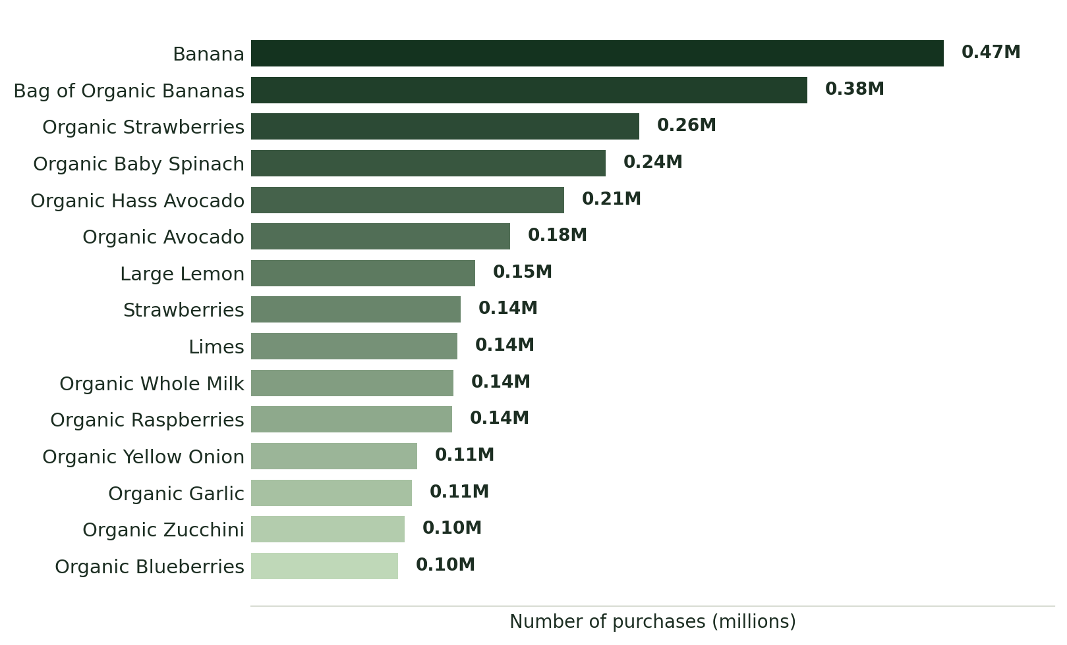
RESULT 01 · PRODUCT DEVELOPMENT
Fresh produce owns the top of the basket
WHAT WE FOUND Every one of the top 15 products is fresh fruit or vegetables.
Grocery Product Placement Analysis · Group 11
06 / 13
Notes:
This is the top-sellers view. Bananas are the single most-purchased product at 0.47 million, followed by Bag of Organic Bananas and Organic Strawberries. The striking thing is that the entire top 15 is fresh fruit and vegetables — and more than half carry an 'Organic' label. The recommendation for Sandra: fresh produce and a credible organic range aren't optional, they're the non-negotiable core of the assortment.

Slide 7
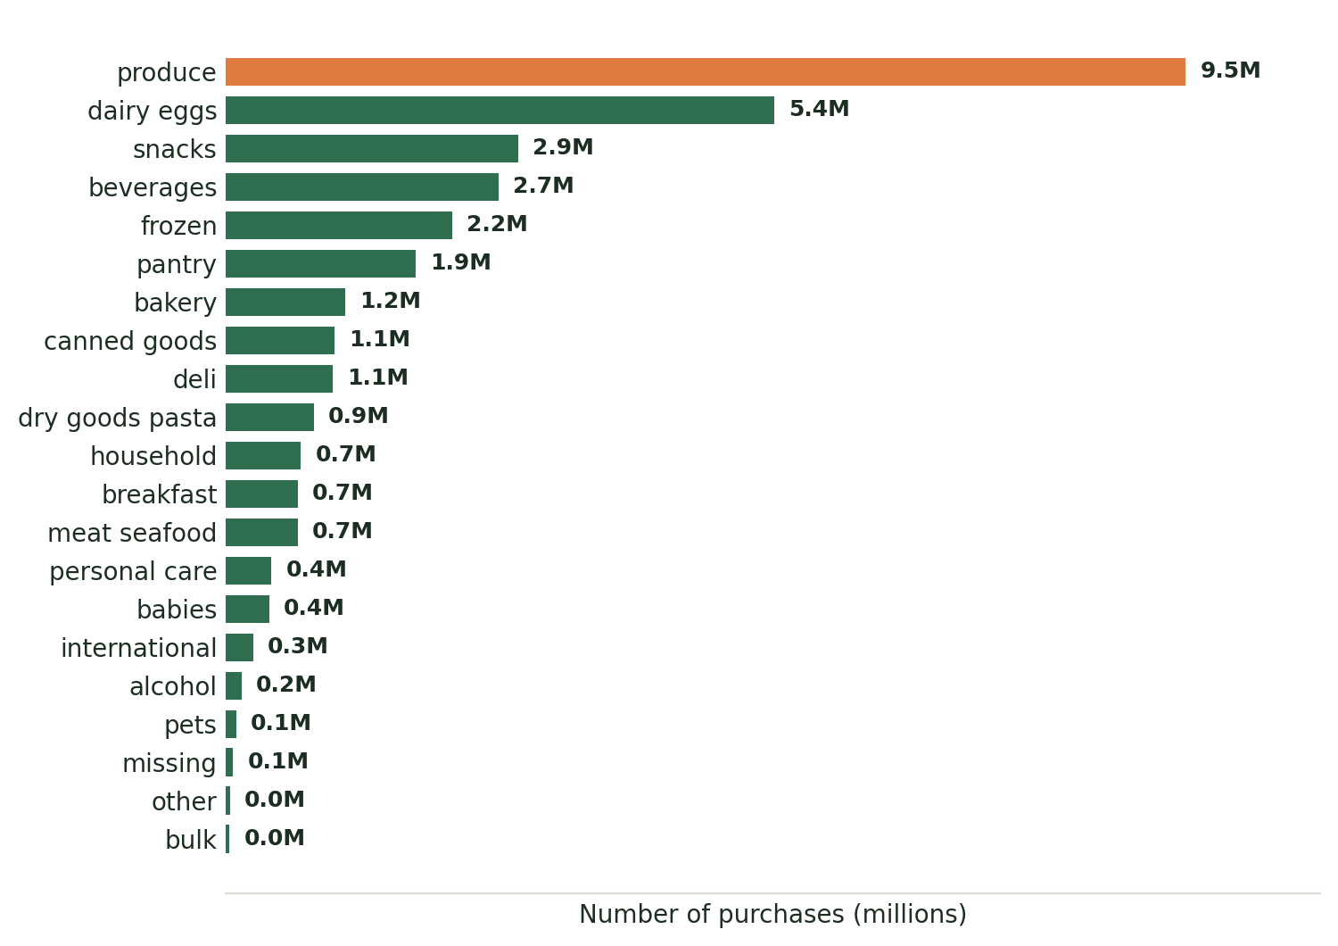
RESULT 02 · PRODUCT DEVELOPMENT
Produce drives almost a third of all volume
WHAT WE FOUND Produce and Dairy & Eggs dwarf every other department.
Grocery Product Placement Analysis · Group 11
07 / 13
Notes:
Stepping up from individual products to departments. Produce drives roughly 9.5 million purchases and Dairy & Eggs about 5.4 million — together nearly half of all volume. The next tier — snacks, beverages, frozen and pantry — is all convenience food. Bulk, alcohol and pets barely register. Recommendation: anchor the assortment on produce and dairy, and treat the convenience categories as the growth layer on top.

Slide 8
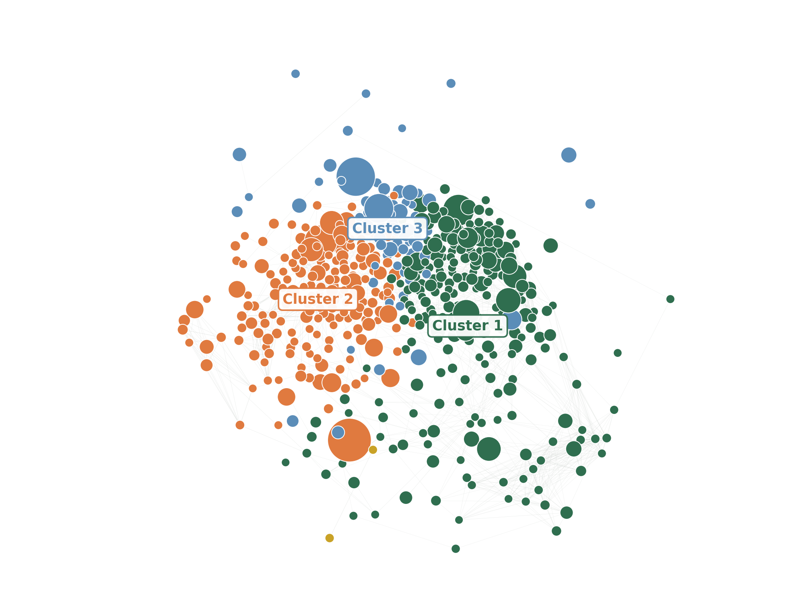
RESULT 03 · PRODUCT DEVELOPMENT
Co-purchase analysis reveals natural baskets
WHAT WE FOUND Co-purchase patterns fall into three natural baskets.
Fresh vegetables & aromatics spinach, avocado, onion, garlic, lemon
Everyday fruit & milk banana, berries, apples, whole milk
The organic basket organic bananas, berries, almond milk
Grocery Product Placement Analysis · Group 11
08 / 13
Notes:
This is the market-basket analysis. We took the 500 most-purchased products and linked any two that are bought together at least twice as often as random chance would predict — that's a lift of 2 or more. Communities of tightly linked products emerge, and three clear clusters stand out: a fresh-vegetables-and-aromatics basket, an everyday fruit-and-milk basket, and a distinctly organic basket. Recommendation for Marco: group cluster members in the same app category, recommend products across the links, and bundle the strongest pairs. One honest note — these clusters come from our own recomputation of the data and differ slightly from an earlier draft, so it's worth confirming the parameters before relying on them.

Slide 9
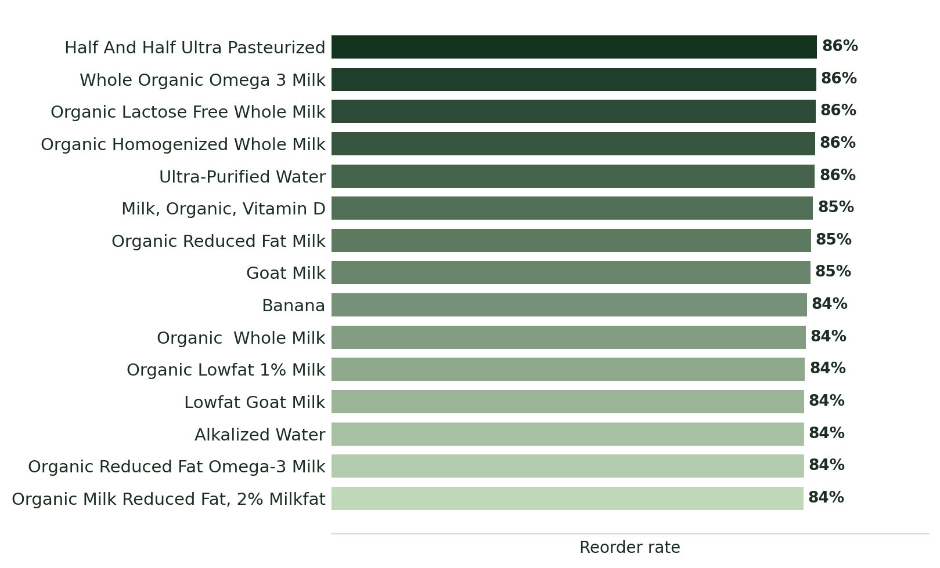
RESULT 04 · CUSTOMER RETENTION
Customer loyalty is built on milk
WHAT WE FOUND Loyalty runs on milk and water — 84 to 86% reorder.
Grocery Product Placement Analysis · Group 11
09 / 13
Notes:
Now to retention. The overall reorder rate across the dataset is 58.9% — that alone tells us this is a highly habitual customer base. When we look at products with at least 500 purchases, the very highest reorder rates, 84 to 86%, are almost entirely milk and water — pure everyday staples. Recommendation: these staples are ideal candidates for subscriptions and automatic reorder reminders.

Slide 10
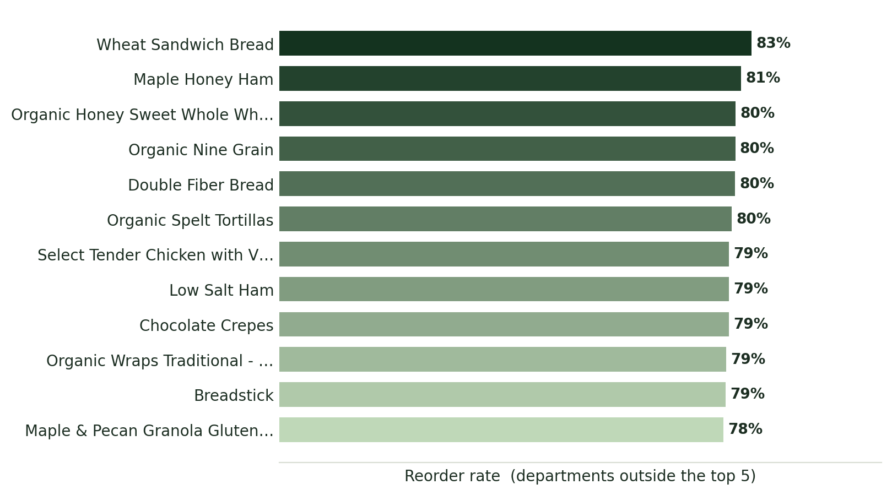
RESULT 05 · CUSTOMER RETENTION
Hidden gems: small categories, loyal fans
WHAT WE FOUND Niche breads and deli items keep 78 to 83% of their buyers.
Grocery Product Placement Analysis · Group 11
10 / 13
Notes:
Hidden gems. Here we deliberately excluded the five biggest departments and asked: what still keeps customers coming back? Breads, hams and wraps reach 78 to 83% reorder rates despite low overall volume — a small but very loyal customer base that is completely invisible in a standard top-sellers report. Recommendation: protect these niche products from delisting; they punch well above their volume in retention terms.

Slide 11
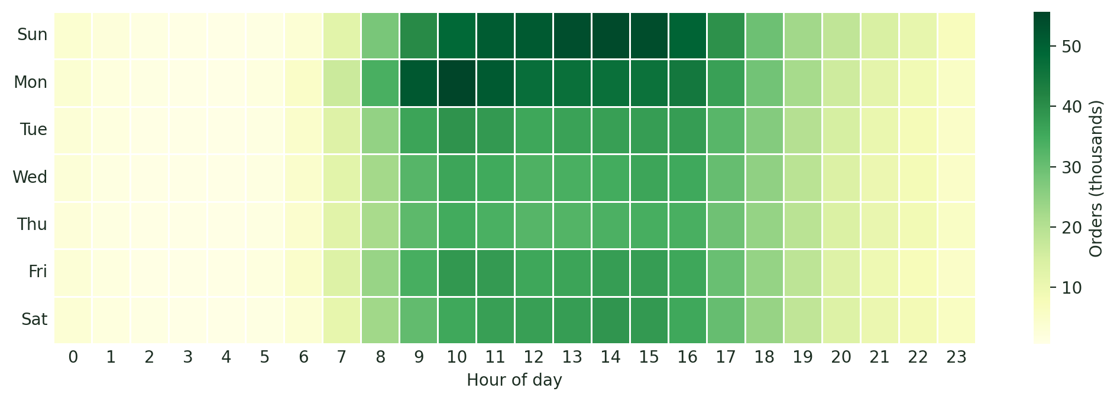
RESULT 06 · CUSTOMER RETENTION
Sunday and Monday mornings carry the week
WHAT WE FOUND
Orders cluster on Sunday and Monday, roughly 9:00 to 16:00 — and fall away sharply outside daytime hours.
Grocery Product Placement Analysis · Group 11
11 / 13
Notes:
Finally, timing. Orders concentrate heavily on Sunday and Monday, roughly between 9am and 4pm — people plan their weekly groceries at the start of the week. Activity falls away sharply before 7am and after 7pm on every day. Recommendation: staff up for that weekly peak, and push promotions on Saturday evening to catch the early planners before the Sunday surge.

Slide 12
WHAT IT MEANS
From data to assortment decisions
01
02
03
04
Build on fresh
Bundle the clusters
Subscribe the staples
Protect the gems
Produce and organic are the core.
Group and cross-sell what sells together.
Milk and water — auto-reorder offers.
Keep loyal niche products on the shelf.
FOR SANDRA
FOR MARCO
FOR SANDRA
FOR MARCO
Grocery Product Placement Analysis · Group 11
12 / 13
Notes:
Pulling it together — four decisions the data supports. One, build on fresh: produce and a credible organic range are the non-negotiable core; that's mainly for Sandra. Two, bundle the clusters: group co-purchased products and cross-sell across the strongest links — that's for Marco. Three, subscribe the staples: milk, water and other high-reorder items are perfect for subscriptions and auto-reorders. Four, protect the gems: keep loyal niche products on the shelf even when their volume looks small. Each one ties straight back to a finding you've just seen.

Slide 13
THANK YOU
Three million orders,
one clear shelf strategy.
Anonymised purchase data, turned into decisions Sandra and Marco can act on — without writing a line of code.
Repository github.com/peslar01/ad24-11-grocery-product-placement-analysis Run it streamlit run deployment/app.py
Lara Pestrin · Jonathan Kull · Veprim Mehmeti
Notes:
To wrap up — the dashboard turns three million anonymised orders into decisions Sandra and Marco can actually act on: faster, more intuitively, and without writing a line of code. The repository and the run command are on screen. Thank you — we're happy to take any questions.

